Slide 1
Transaction Cost Issues in Agriculture
Binswanger and Rosenzweig, JDS 1986

Slide 2
Objectives: (1) Explain the diverse production relations (as did Marx) but those observed in rural environments where markets often incomplete
(2)Predict effects of various changes

Slide 3
Individuals face two problems at same time
Maximize consumption and leisure (through income)
Mitigate risks and hence want to smooth consumption over time
Hence production relations should be adopted to both problems in situations characterized by asymmetric information and hence incentive problems or adverse selection, moral hazard

Slide 4
Importance of Collateral
For mitigating risk to lender and incentive for default on the part of the borrower
Without collateral, lenders likely to restrict their lending
  To very small loans
  To owners rather than tenants
  To resident rather than migrant workers
  Hence, Personal characteristics matter in credit markets

Slide 5
Determinants of the value of collateral
Appropriability (extent to which the collateral can be useful to the lender on default by the borrower)
Absence of collateral - specific risk such as that it can be stolen, lost in fire
Accrual of returns of the asset to the borrower (unlike jewelry)

Slide 6
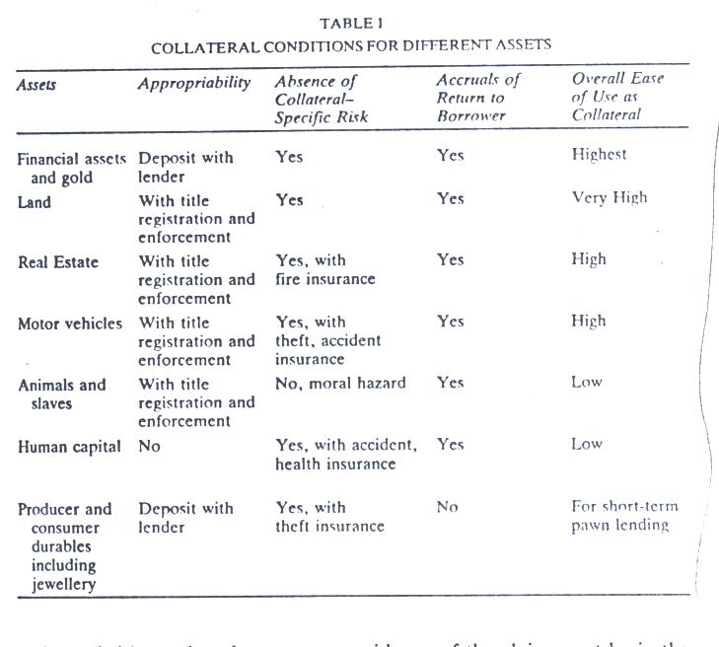
Collateral value of different assets

Slide 7
Collateral Substitutes
Third party guarantees
Threat of loss of future borrowing opportunities
Because of the usefulness of credit as an insurance substitute, assets with high collateral value may be valued above what their production or consumption value would warrant

Slide 8
Characteristics of Agriculture of relevance to Insurance and Financial intermediation
Immobility of land Dispersion of production
Transport costs high
Seasonality
Positive correlation of crop growth cycles across land plots
High information costs: incentive problems
Risks : yields, price, timing, asset and other breakdowns
Absence of crop insurance. But there may exist specific insurance against hail, hurricane, fire, even drought

Slide 9
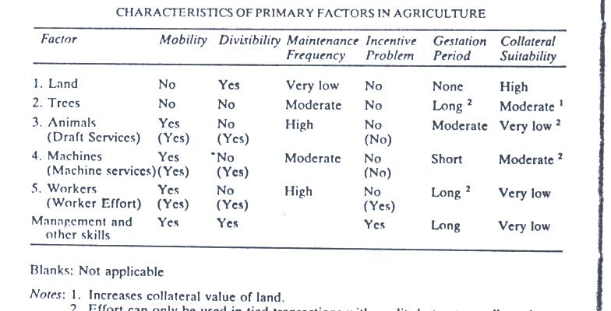

Slide 10
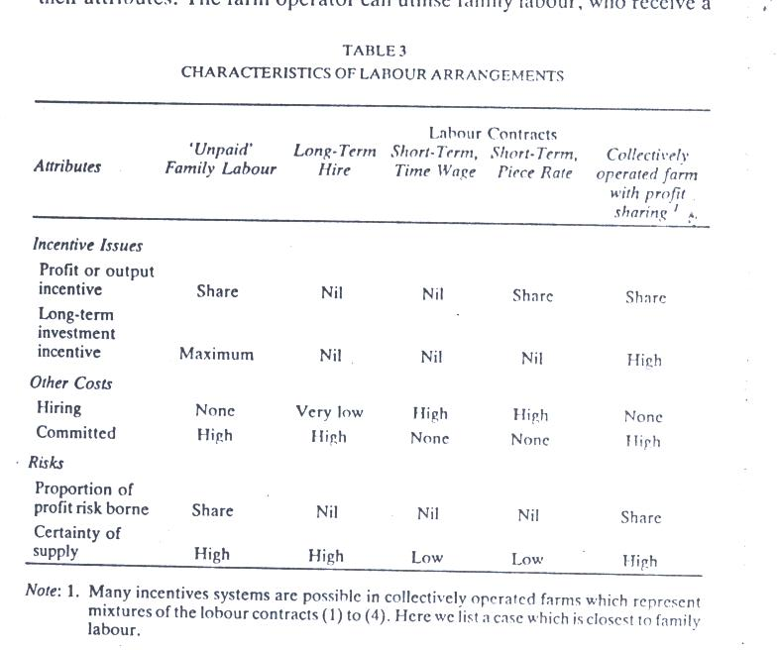

Slide 11
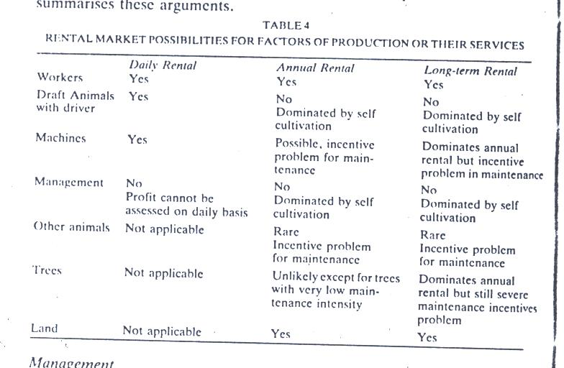

Slide 12
Production technology and scale economies
Importance of coordination costs due to perishability
Possible economies of scale in some operations (such as distribution, marketing) and some crops

Slide 13
Assume High Population Density
Rental Market for land more likely than rental market for animals or equipment
Transaction costs of tenancy on land of given size rise with the number of tenancy contracts
To reduce these land reform may be useful, with self-cultivation on each plot
Thanks to risk, land assets are more valuable and this discourages land sales

Slide 14
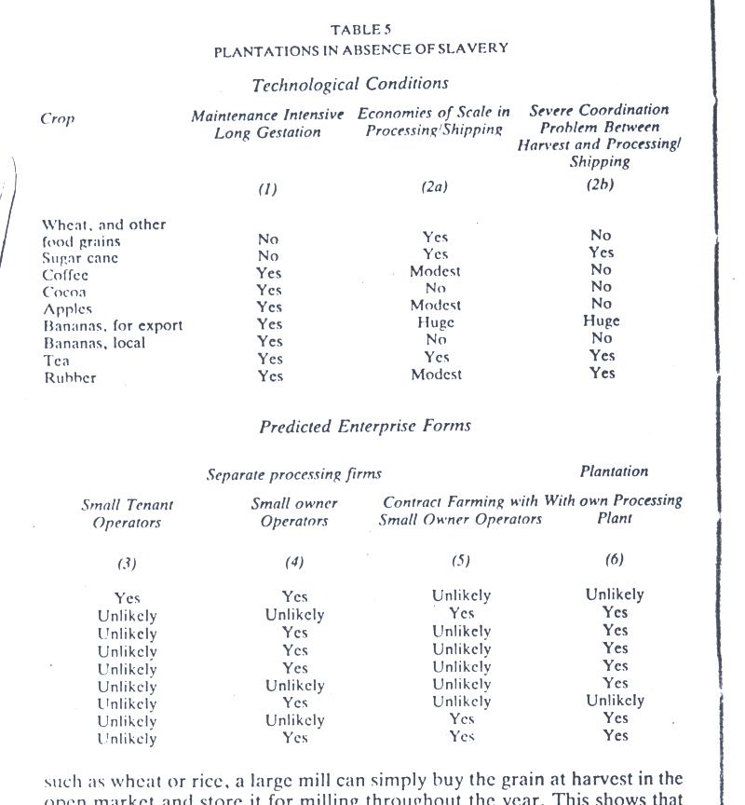

Slide 15
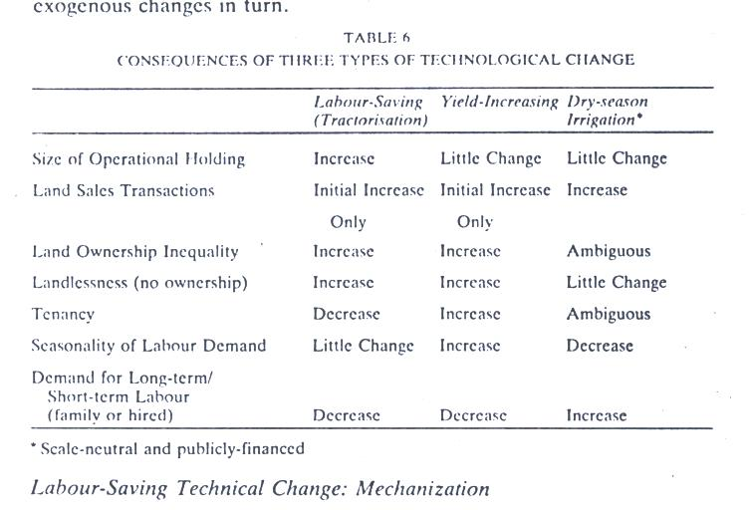

Slide 16
Incompleteness of key intertemporal markets
May prevent Pareto efficiency from being realized.

Slide 17
Binswanger and McIntire EDCC 1987
Extension to Land Abundant Cases
  Pop. Density low
  Indigenous pop. Has access to land-use rights at extremely low cost
  In arid climate, seasonality greater, growing season shorter and more risky
  Animal husbandry and transhumance
  Technology very simple
  Transport, comm. Costs high, absence of slavery
  Cultivated area per HH is not affected by wealth
  No hiring or exchanging labor during peak
  Market for output extremely underdeveloped

Slide 18
Additional Characteristics
Once subsistence consumption met, marginal utility of effort declines sharply
Plot diversification strategy
Social institutions like tribes with extensive area
Capital accumulation as insurance substitute, Foodstock accumulation, esp. animals
Credit markets underdeveloped (poor collateral) and little demand
Common property as insurance substitute

Slide 19
